Slide 1


Decision Making, Systems, Modeling, and Support
Dr. Parthasarathi Pattnayak

Slide 2
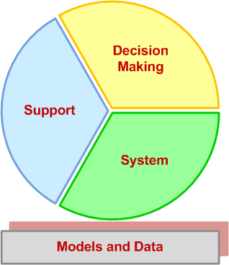
Decision Support Systems (DSS)
Dissecting DSS into its main concepts
Dissecting DSS into its main concepts
Building successful DSS requires a through understanding of these concepts

Slide 3
Characteristics of Decision Making
Groupthink
Evaluating what-if scenarios
Experimentation with a real system!
Changes in the decision-making environment may occur continuously
Time pressure on the decision maker
Analyzing a problem takes time/money
Insufficient or too much information

Slide 4
Model
A significant part of many DSS and BI systems
A model is a simplified representation (or abstraction) of reality
Often, reality is too complex to describe
Much of the complexity is actually irrelevant in solving a specific problem
Models can represent systems/problems at various degrees of abstraction

Slide 5
Types of Models
Models can be classified based on their degree of abstraction
  Iconic models (scale models)
  Analog models
  Mental Models
  Mathematical (quantitative) models
Less
Degree of abstraction
More

Slide 6
Phases of Decision-Making Process
Humans consciously or sub consciously follow a systematic decision-making process - Simon (1977)
  Intelligence
  Design
  Choice
  Implementation
  (?) Monitoring (a part of intelligence?)

Slide 7
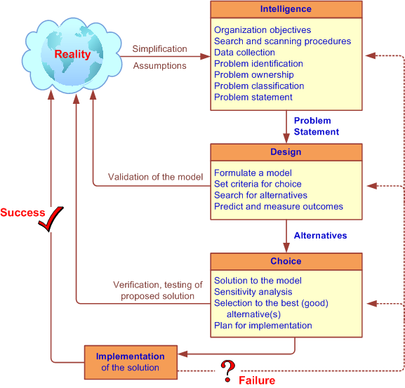
Simon’s Decision-Making Process

Slide 8
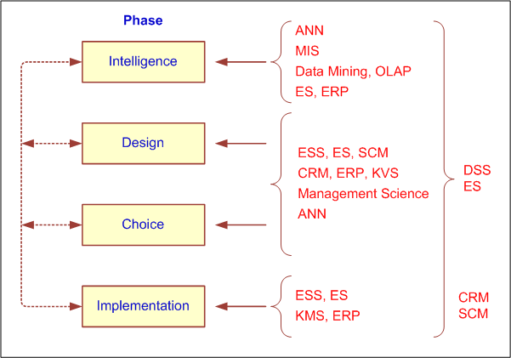
How Decisions Are Supported

